Slide 1
Knowledge Consumption

Slide 2
So far…
We have discussed techniques to:
Refine raw text into a more structured form using linguistic features (POS, parsing, etc)
Extract Information from large amounts of text
Traditional Information Extraction
Open Information Extraction
Link the Extracted Information to existing Knowledge Bases (entities and words)
And now…

Slide 3
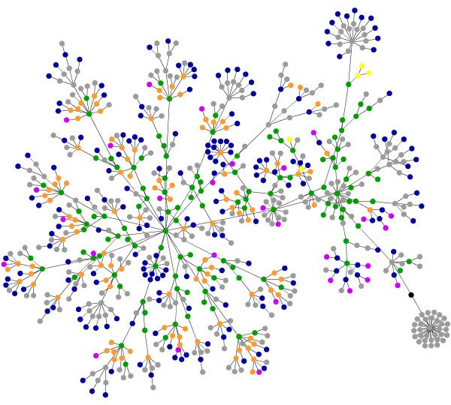
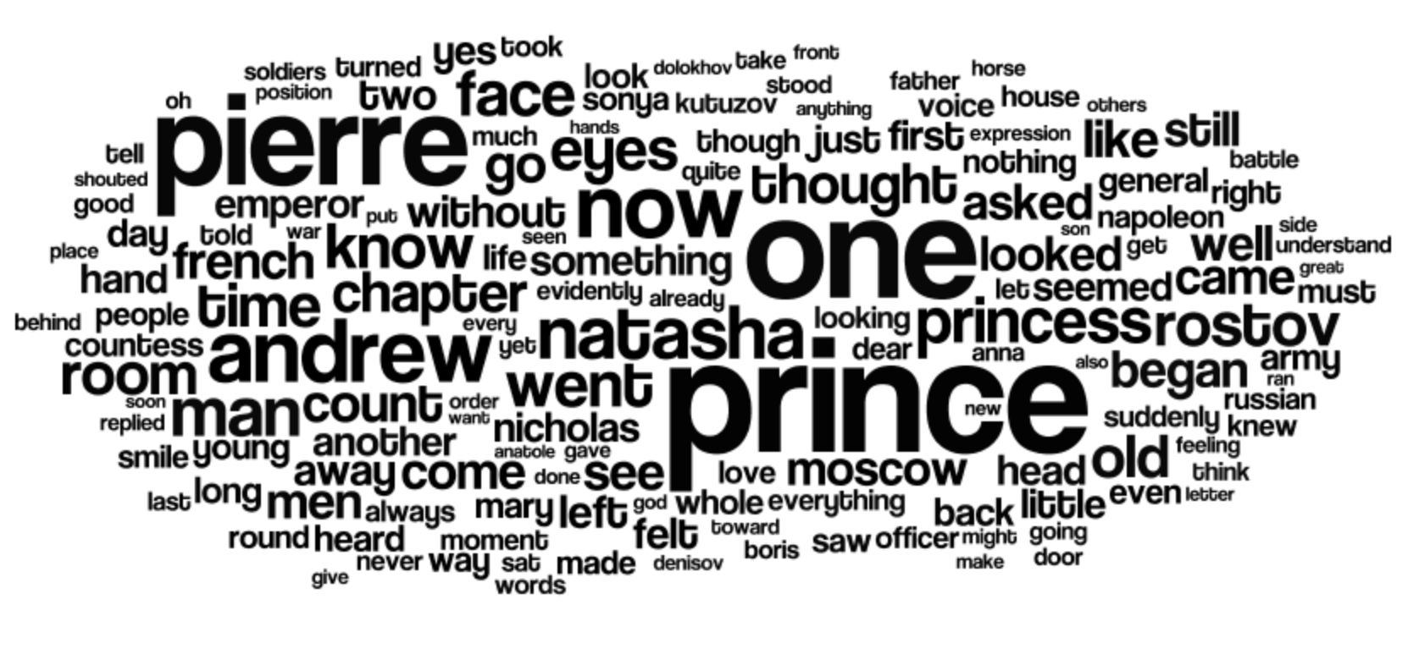
And now …
We are going to discuss non-trivial processing of the knowledge that we acquired from the Web
Latent Knowledge (work done mainly in the Machine Learning community)
Manifest Knowledge (work done mainly in the Knowledge Representation community)
The input of our process is going to change: From Text to Graphs

Slide 4
Latent Knowledge

Slide 5
Latent Knowledge
The line of works in this domain is connected by two principles
Meaning is use
Everything (or almost everything) can be learnt

Slide 6
Latent Knowledge
The line of works in this domain is connected by two principles
Meaning is use
Everything (or almost everything) can be learnt
“Meaning is use” is a slogan originally proposed by Wittgenstein which has been frequently (ab)used in statistical research in NLP
Words are not defined by reference to the objects they designate, but how they are used
Controversial

Slide 7
Latent Knowledge
The line of works in this domain is connected by two principles
Meaning is use
Everything (or almost everything) can be learnt
Latest progresses in Machine Learning show that large amounts of data lead to models that capture non-trivial relations between concepts => Everything can be learned
“In order to fly, all one must do is simply miss the ground.” Douglas Adams
Controversial

Slide 8
Latent Knowledge
The line of works in this domain is connected by two principles
Meaning is use
Everything (or almost everything) can be learnt
My point of view: I reject universal symbolic representation (”objects words refer to”), but I also believe that not everything can be learned
Controversial

Slide 9
Latent Knowledge on the Web
Let’s move away from philosophical considerations and look at the technical aspects
Let’s first look at text again …
What kind of latent knowledge can we extract from KBs?

Slide 10
word2vec
word2vec is a class of methods to to map words in a low-dimensional continuous vector space
Each word is mapped to a vector of real values. These vectors encode “instructions” to the latent meaning of the word and are called embeddings
word2vec was proposed by Google and is now widely used!
These vectors are constructed following the principle: “You shall know a word by the company it keeps” Firth, 1957
The vectors can be constructed using two models:
Skip-gram
Continuous bag-of-words (CBOW)

Slide 11
word2vec
The vector embeddings can be used for a variety of reasons:
Word similarity
Analogies
Etc.
Example: Vector(France) + Vector(Paris) – Vector(Italy) = ?

Slide 12
word2vec
Skip-gram model
Goal: Given one word, predict the ones around it
We can look at words that appear around w in an existing corpus and train a model that, given w, returns the best scores for words such as the ones we observed in our corpus
?
?
w
?
?
?

Slide 13
word2vec
Skip-gram model
Goal: Given one word, predict the ones around it
More formally, we want to maximize a function like
?
?
w_{t}
?
?
?

Slide 14

word2vec
Skip-gram model
How can we implement the conditional probability p?
We assign two vectors of real numbers ${v^{′}}_{W_{I}}$ and $v_{W_{O}}$for each word in the vocabulary W and calculate p as:

Slide 15

Machine Learning digression
Remember: Our goal is to maximize
How can we learn good values of ${v^{′}}_{W_{I}}$ and $v_{W_{O}}$ to this end?
Why is p so complex?

Slide 16

Machine Learning digression
Remember: Our goal is to maximize
How can we learn good values of ${v^{′}}_{W_{I}}$ and $v_{W_{O}}$ to this end?
Why is p so complex?

Slide 17
Machine Learning digression
The gradient of a function tells a direction of change Gradient: vector with the partial derivatives on each parameter of the model (in our case the list of vectors)

Slide 18
Machine Learning digression
During training, we replace our function with existing sequences of words. This gives a set of scores
In order to increase the scores, we change the values of the vectors following the indication of the gradients
We repeat this process more times

Slide 19

Machine Learning digression
Remember: Our goal is to maximize
How can we learn good values of ${v^{′}}_{W_{I}}$ and $v_{W_{O}}$ to this end?
Why is p so complex?

Slide 20
Machine Learning digression
In machine learning, such function is called softmax
Even though, at first sight it looks unnecessary complex, in practice it has very useful properties:
exp() is smooth and non-linear
Sum is 1 (probabilities)
Calculating the gradient is very simple:

Slide 21
word2vec
Skip-gram model
The original formulation of is expensive to calculate because it is proportional to the size of the dictionary (W)
Two techniques improve the execution: Hierarchical softmax and Negative Sampling

Slide 22
word2vec
Continuous Bag-of-Words (CBOW)
Alternative method to perform the same task
In this case, the prediction is different: Given a context (w1, w2, w3,w4, w5), what’s the probability that a new word appear?
w1
w2
w3
w4
w5
?

Slide 23
word2vec
The products between the vectors can be calculated using a multi-layer neural network
In word2vec, the weights are trained using standard backpropagation
CBOW is significantly faster (because most of the computation is required in the second layer), but Skip-Gram is more accurate (CBOW embeddings are averaged)
Skip-Gram
CBOW

